Slide 1





SSR Inc.
Raising the Capability Maturity of Cybersecurity Function
Ray​
Chang ​
Will Dannacher
Akshitha Shankar ​
Vahin Vuppalanchi​
September 15, 2023
These slides were part of an oral presentation by Team 9 for the MSIS Program GRC case study. These slides are not a complete record of that presentation, nor of the accompanying discussion. The slides are protected by copyright law and may not be reproduced, in whole or in part, without the express written consent of the author.

Slide 2

Agenda
Background
Recommendations
Implementation
Financials
Risk
Conclusion
02
Agenda
Introduction
Solution
Timeline
Financial Analysis
Risks & Mitigations
Conclusion

Slide 3



Agenda
Background
Recommendations
Implementation
Financials
Risk
Conclusion
03
Evaluating SSR's Cybersecurity Capability
SSR Inc. is new firm formed from a merger of three distinct companies each specializing in a different sector. Despite the success of the organization, they initially struggled to implement an IT department. Since, they have continued a solid position in their industry and have organized their IT systems sufficiently.
Previously,
However,
The security implementation process included a few gaps in their overall cybersecurity program which led to a ransomware hack compromising their systems, data, and daily operations.
Now,
How can SSR Inc. enhance their security protocols to create a more robust cybersecurity infrastructure and business environment?
https://thestrategystory.com/blog/kroger-swot-analysis

Slide 4
Agenda
Background
Recommendations
Implementation
Financials
Risk
Conclusion
04
Our Recommendation is a Three-Pronged Approach to Restructure the Security Functions
Governance
Control
Incident Management
Established dedicated Security Department with accountability & Responsibility to push effective policies and standards to secure SSR’s Business
Enforce Effective Security Control to Monitor, Detect and Mitigate Risk and Eventual Ensure the Security for SSR
Establish a robust Business Continuity Plan to ensure quick turnaround of operations
Outline a process for Managing Security Incidents and enhance knowledge base

Slide 5
Agenda
Background
Recommendations
Implementation
Financials
Risk
Conclusion
05
It’s Crucial to Bolster Cybersecurity Functions at SSR
The 3 R’s of Cybersecurity
Manage Risks
Effective threat mitigation allows a firm to assess incoming risks and develop preventative measures for the future
Quick Response & Recovery
Ensure that the firm can detect risks before they become a major issue
Minimize damages caused by threats and accelerate response time
Optimize Resource Allocation
Certify that investments made into cybersecurity align with what the firm is trying to accomplish

Slide 6


Agenda
Background
Recommendations
Implementation
Financials
Risk
Conclusion
06
Governance
Ensure Responsibility & Accountability
Develop Security Metrics
Promote Director Simmons to CISO, reporting to CIO, with accountability for IT risk management, compliance and cybersecurity to safeguard SSR's technology assets
Increase budget towards IT risk management, IT compliance and cybersecurity to match organizations of this size and established a dedicated department
Have multiple executives led by the CISO involved in the implementation and development of this greater cybersecurity function
Enhance the existing measures by including additional metrics regarding other elements of security beyond SLAs and effectiveness tickets [APO13]
Include specific metrics regarding employee competency and training completion
Develop risk scenario simulations to determine percent effective security
Continuously monitor these metrics via scheduled reviews and number of findings
https://www.educause.edu/focus-areas-and-initiatives/policy-and-security/cybersecurity-program/resources/information-security-guide/toolkits/effective-security-metrics
https://blog.24by7security.com/you-probably-need-a-security-governance-committee-and-heres-why
https://www.paloaltonetworks.com/blog/2022/06/the-importance-of-a-consistent-security-policy/

Slide 7
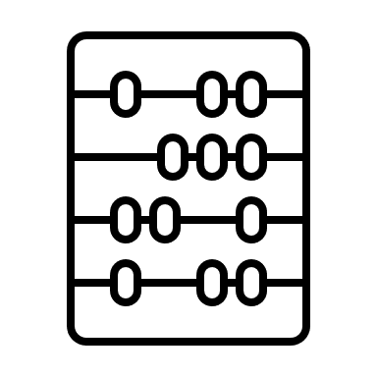



Agenda
Background
Recommendations
Implementation
Financials
Risk
Conclusion
07
Control
Manage
Vendor Risk
Standard Enforcement & Security Monitoring
Consolidate Data and Maintain Integrity
Integration of Applications and Teams
Subscribe to security and risk management providers to detect attacks and data breaches to quickly
Determine if an attack that happens on the vendor side puts SSR at risk
Enforce policies and standards like ISO 27001, ISO 27002, NIST800-53, NIST CSF and COBIT
Enhance capabilities in detecting abnormal user and entity behavior within the network to identify and reduce insider threats
Leverage AI to improve threat detection by identifying subtle anomalies and patterns that may be indicative of an attack
Alerts the security analyst and administrators when the system detects a security incident or a potential threat for further investigation and response
Create a centralized asset repository
Capture, store, and monitor all data
Track changes in the location of assets
Automate the generation of inventory and asset reporting
Develop a clear and accessible interface for all employees to use
Automate data inflow and sanitization
Ensure that the PCI and operational security team are not isolated
Use a framework that allows teams to build off each other instead of forcing collaboration
Continue to manage relationships between teams
Maintain constant communication through a framework like SCRUM
https://www.nudgesecurity.com/
https://www.hpe.com/emea_europe/en/what-is/central-repository.html
https://content.solarwinds.com/creative/pdf/whitepapers/it_asset_management_%20benefits_%20best_practices.pdf
https://nickols.us/~nickols1/Learning.pdf
COBIT 2019 Framework: Governance and Management Objectives
Notes:
For example, Nudge Security, an existing player that provides risk and security insights for every SaaS vendor used by a company and alerts breaches of any SaaS vendor

Slide 8


Agenda
Background
Recommendations
Implementation
Financials
Risk
Conclusion
08
Incident Management
Business Continuity Plan
Change Management
Establish a Cross-functional Team comprising IT, Cybersecurity, Forensics and Legal
Comprehensive continuity plan and scope determined by key stakeholders outlining roles, responsibilities and procedures [DSS04]
Enable efficient communication channels
Identify internal and external business processes and activities critical to operations and impact on security [ DSS 04]
Establish Recovery Protocols – Third Party Services
Regular Employee Cyber Training to reduce human errors
Identify security incidents and classify them into groups based on the severity or impact on operations [DSS02]
Establish knowledge resources and provide extensive Training for the team [DSS02]
Handle all incidents formally with access to all relevant data [ DSS03]
Define appropriate support teams to assist with root cause analysis and optimal solution determination [DSS 03]
https://www.salvagedata.com/phases-of-an-effective-incident-response-plan/ https://www.salvagedata.com/data-recovery-services/ COBIT 2019 Framework: Governance and Management Objectives

Slide 9
Agenda
Background
Recommendations
Implementation
Financials
Risk
Conclusion
10
Quarterly Key Milestones & Capability Improvements
Ecosystem
2024 Q1
2024 Q2
2024 Q3
2024 Q4
Security Metrics Established
Configured and Integrated Nudge Security into SSR’s System
Consolidate Data and Maintain Integrity
Dedicated Security Department
2025 Q1
2025 Q2
2025 Q3
2025 Q4
Business Continuity Plan Complete
Integration of Applications and Teams Completed
Monitor Enforcement and Security
Change Management Process Finished
11

Slide 10
Agenda
Background
Recommendations
Implementation
Financials
Risk
Conclusion
09
A 2 Year Blueprint for Developing Governance, Controls, and Incident Management
Task
2024
2025
Q1
Q2
Q3
Q4
Q1.
Q2.
Q3.
Q4.
Governance
Ensure Responsibility & Accountability
Develop Security Metrics
Control
Manage Vendor Risk
Standard Enforcement & Security Monitoring
Consolidate Data and Maintain Integrity
Integration of Applications and Teams
Incident Management
Business Continuity Plan
Change Management
Control

Slide 11
Agenda
Background
Recommendations
Implementation
Financials
Risk
Conclusion
11
Financials
Ensure Security Quickly and Cost Effectively
Cost Breakdown:
Cost | Amount | Type | Frequency
Vendor Risk Management Platform Subscription | $2-3 per verification minimum 150 users | Recurring | Monthly
Labor | $300K-350K | Recurring | Monthly
Security Monitoring Capabilities Enhancement | $150K | Recurring | Quarterly
Data Consolidation | $400K – $1M | Upfront | N/A
Integration and Collaboration | $100K | Upfront | N/A
Data Recovery Service | $40K | As Needed | N/A
https://www.capterra.com/resources/risk-management-software-pricing-report/
https://www.scnsoft.com/analytics/data-consolidation#:~:text=Data%20Consolidation%20Project%20Costs&text=Small%20companies%3A%20%2470%2D200K,Large%20companies%3A%20%24400%2D1%2C000K

Slide 12
Agenda
Background
Recommendations
Implementation
Financials
Risk
Conclusion
12
Risks & Mitigations
Operational and Compliance Consequences Might Occur Without Proper Planning
Risk
Degree
Mitigation
Communication Breakdown
Shifting responsibilities can cause disruption in communication channels inside the organization.
Probability
Be transparent in all communications with employees and higher up business personnel
Communicate the hierarchy of responsibility for all aspects of the operational model to all employees of SSR
Governance
Severity
 | X
Reliance on a Single Data Repository
Relying on a single vendor for a centralized system can restrict current flexibility and future innovation
Regulatory Compliance
Failure to comply with legal boundaries can result in regulatory and financial consequences.
Ensure that when a contract with a repository vendor ends, all data is backed up and able to be transferred to a new system
Do research on the legal landscape of all regions SSR will operate in
Reliance on a Single Data Repository
Relying on a single vendor for a centralized system can restrict current flexibility and future innovation
Regulatory Compliance
Failure to comply with legal boundaries can result in regulatory and financial consequences.
Probability
Probability
X
X
Control
Severity
Control
Loss of Essential Data During Recovery
Probability
Align with data protection regulations (ISO27001/ISO27002, NIST CSF, COBIT, etc.)
Partner with third-party data recovery vendor to minimize risk of data loss
Severity
Losing data in the event of a security breach can be devastating to companies and result in financial and legal concerns.
 | X
Incident Management
business.com/articles/rfid-for-retail/
holisticai.com/blog/recommendation-systems

Slide 13

Agenda
Background
Recommendations
Implementation
Financials
Risk
Conclusion
13
A Proactive Step to Shape SSR's Future
With the presence of cyberthreats to companies in any industry, a sound cybersecurity practice is vital to an organization's long-term health.
Preventing against any incoming cybersecurity threats is key to ensuring business continuity, financial safety, and overall protection from outside threats if these standards are in place.
Following all steps of the recommendation will ensure the highest level of confidence possible to protect against future attacks and help sustain Shop, Stop, and Roll as a prominent figure in their industry for years to come.
Thank you!

Slide 14
APPENDIX

Slide 15
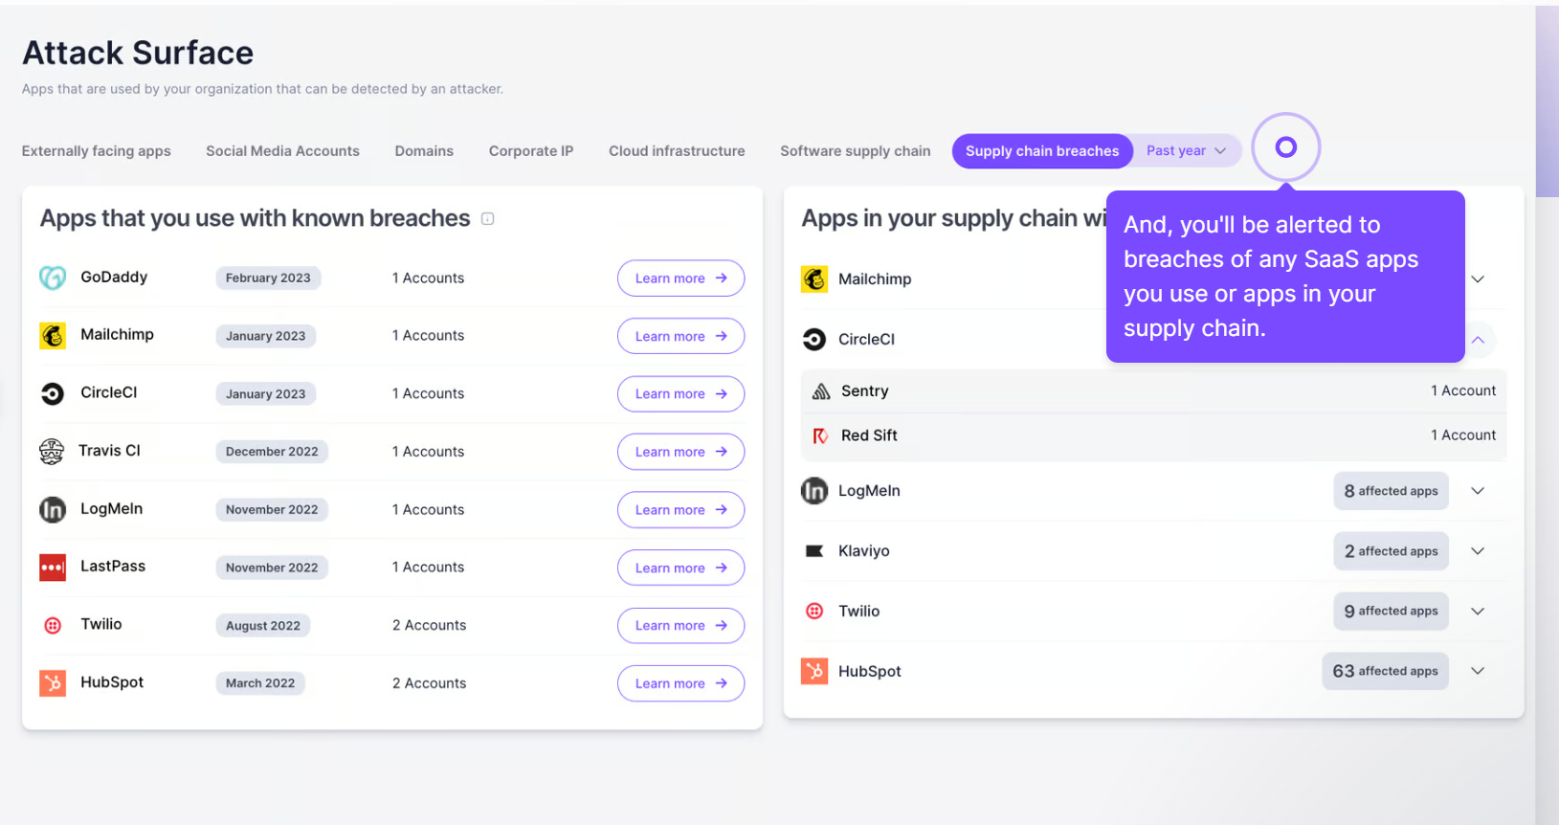
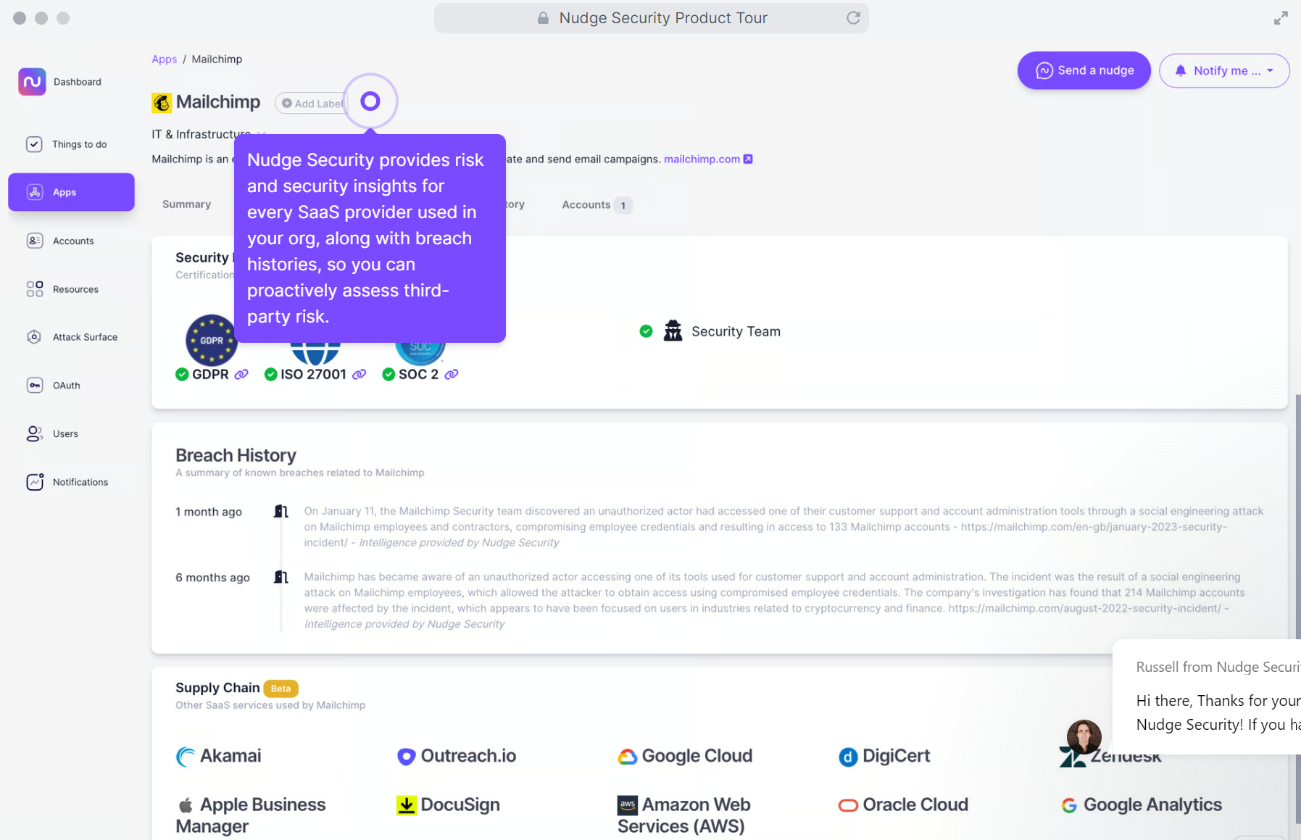
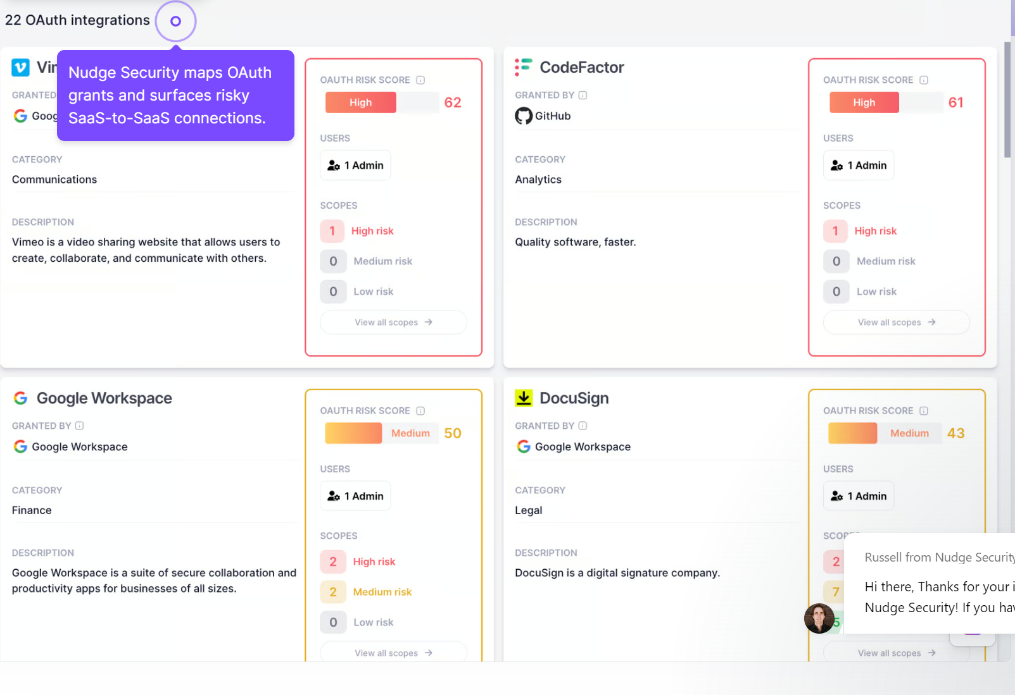
Vendor Risk Management- Nudge security

